Slide 1


Zorigt Udaanjargal
2022/07/10

Slide 2

Outline
Executive Summary
Introduction
Methodology
Results
Conclusion
Appendix

Slide 3
Executive Summary
Data collection
Used SpaceX API and web scraping of falconx9 launches from Wikipedia
Data cleaning and analysis
Used Python libraries and SQL to clean, organize and explore the data
Results:
All of the data was publicly sourced and enough to come to reasonable conclusions
Machine learning model used to predict successful landings yielded an 83% accuracy.

Slide 4
Introduction
The commercial space age is here, companies are making space travel affordable for everyone.
SpaceX saves up most of its costs by reusing the first stage
Space Y needs to determine:
What makes the first rocket’s landing successful
Where, how and why
Develop a model that can successfully predict if the landing will be successful or not

Slide 5

Section 1

Slide 6
Methodology
Executive Summary
Data collection methodology:
Data was collected from 2 sources:
SpaceX API (https://api.spacexdata.com/v4/)
Web scraping (https://en.wikipedia.org/wiki/List_of_Falcon\_9\_and_Falcon_Heavy_launches)
Perform data wrangling
Based on the raw data, categorization of the landing’s success was achieved for every site and rocket.
Perform exploratory data analysis (EDA) using visualization and SQL
Perform interactive visual analytics using Folium and Plotly Dash
Perform predictive analysis using classification models
Data was normalized and then built 4 models that were trained and tested for maximum accuracy

Slide 7
Data Collection
Two methods of data collection were used:
SpaceX API for:
Rockets
Launch pads
Payloads
Cores
Data ranging from 2006 to 2020
Web scraping a Wikipedia page of falcon9 landings

Slide 8
Data Collection – SpaceX API
Using SpaceX’s API we obtained following data:
The date and location of the landing
The payload of the cargo in kgs
The name and the outcome of the rocket
Data collection notebook
Data request from SpaceX API
Concatenation of all the different data frames into one data frame
Fill in all the missing values with based on the other values from the data frame

Slide 9
Data Collection - Scraping
Used beautiful soup to get the page in order to manipulate the page
Scraped through the elements to identify the table of data that we need
Turned it into a pandas dataframe
Web scraping notebook
Request the page to get data by using beautiful soup
Identify <th> elements to get the relevant data
Put all the relevant data into a pandas data frame

Slide 10
Data Wrangling
Determine training labels
Normalization and creation of training labels
EDA to find patterns
Data was explored using pandas library to determine what label would be suitable for a supervised ML model
Using data normalization it was possible to extract outcomes as either 0 (failure) and 1(success)
Data wrangling notebook

Slide 11
EDA with Data Visualization
To find a pattern and relevant columns and values that will be used for the ML model:
Scatter plots were used to find relationships between launch site, number of flights,orbit and payload of the rocket.
Line chart was used for determining how successful over the years the rocket landings have become
EDA visualization notebook

Slide 12
EDA with SQL
Following insights were drawn using SQL on our Data frame:
Name of launch sites and a sample of launch records for each site
Sum and average of payloads launched
List of boosters with certain payloads and maximum payloads
List of successful and failed mission outcomes
List of failed missions and their parameters
SQL notebook

Slide 13
Build an Interactive Map with Folium
An interactive map was built with Folium to see if there were any location based factors for landing successes. Following objects were added
Circles and markers (To indicate where missions took place)
Cluster markers in green and red (To show which sites had more successful and failed missions)
Red lines (to indicate distances between launch sites and landmarks like the beach, railroads and so forth)
Folium map notebook

Slide 14
Build a Dashboard with Plotly Dash
Dash dashboard includes:
Dropdown selector for launch sites
Payload range slider
Pie chart for the success rate of missions per launch site
Scatter plot to show the relationship between payload mass, booster version, and the success rate
This dashboard provides a clearer view on how sites, payload mass and booster versions affect the success rate for the mission
Plotly dash Dashboard

Slide 15
Predictive Analysis (Classification)
With the independent variables chosen and the values normalized we used 4 classification models to predict the next success rate of a mission:
Logistic Regression
Support Vector Machine
Decision Tree Classifier
K Nearest Neighbors
Model training process:
Classifier models notebook
Transform and split data into training and test parts
Test the models with the testing portion of the data
Check the accuracy score for each model and choose the most accurate one
Fit and train the 4 classification models
Test

Slide 16
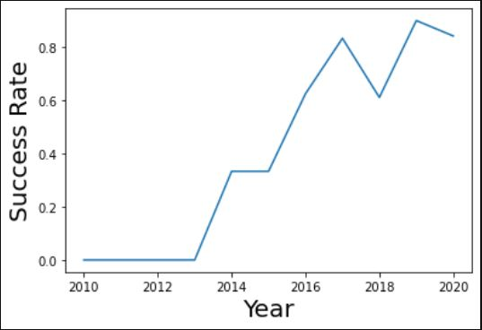
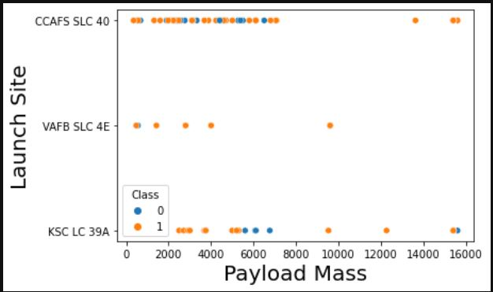
Results
Exploratory data analysis results
Mission success rates improve over the years
Payload weight-wise most successful missions are in the range of 2K-6K kg’s with the mean Falcon 9 payload being ~2.5K kg’s
The more flights were done the better the success rate was, but the data doesn’t explain why

Slide 17
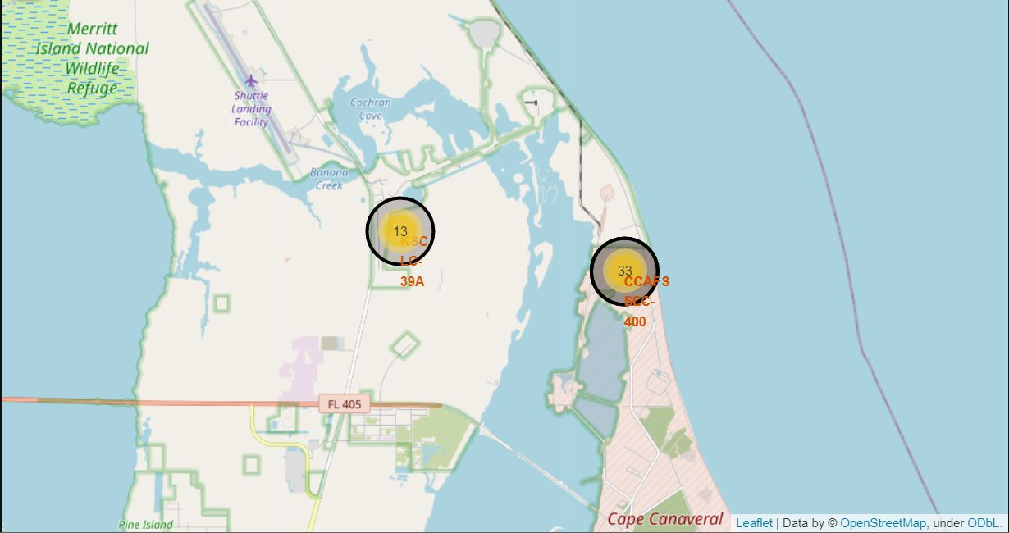
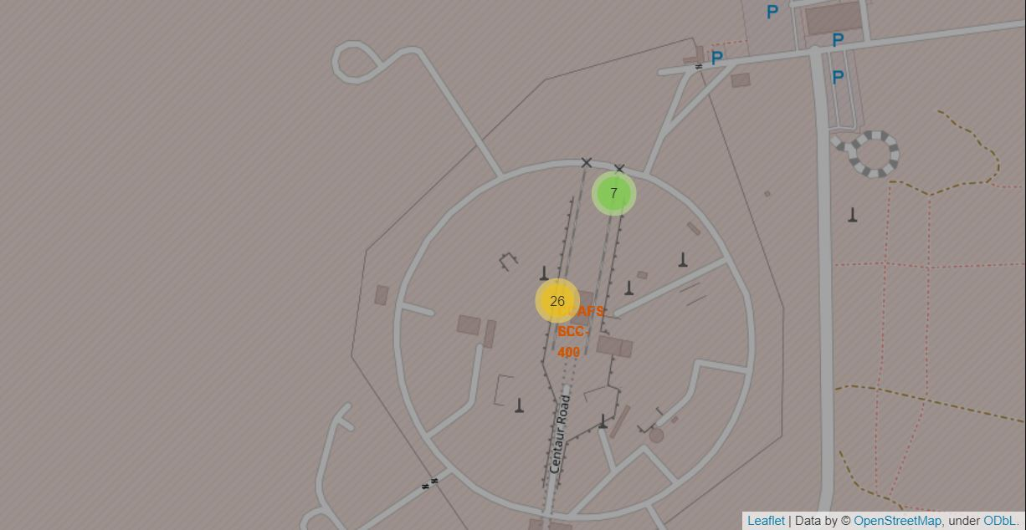
Results
Most of the launches were done in the east coast Florida.
Most of the launches were done in Cape Canaveral Space Force Station but the launches near Kennedy Parkway were more successful

Slide 18
Results
Predictive analysis results
Due to the small size of the data all the models yielded same test accuracy of 83.33%
However Decision Tree model showed a bit higher accuracy than the others
Model | Accuracy | Test Accuracy
LogReg | 84.6% | 83.3%
SVM | 84.8% | 83.3%
Tree | 88.9% | 83.3%
KNN | 84.8% | 83.3%

Slide 19

Section 2

Slide 20
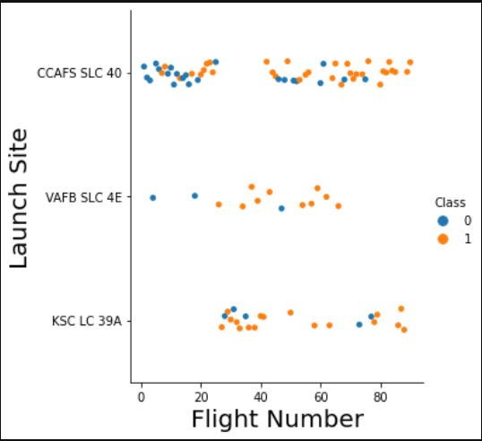
Flight Number vs. Launch Site
Most launches occur at the CCAFS SCL – 40 Launch site
It can be observed that the other 2 launch sites have fewer but better success rates
The more flights taken the better the success rate at all launch sites
* 1 = success, 0 = failure

Slide 21
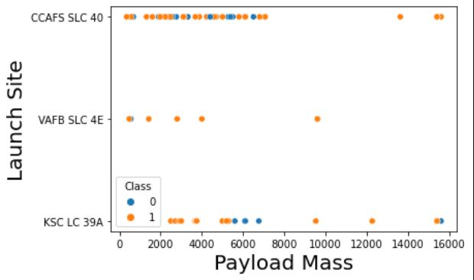
Payload vs. Launch Site
Most launches have a payload mass range of 2K-6K
Launches with more than 10K kilograms are most successful but they were rarely launched
* 1 = success, 0 = failure

Slide 22
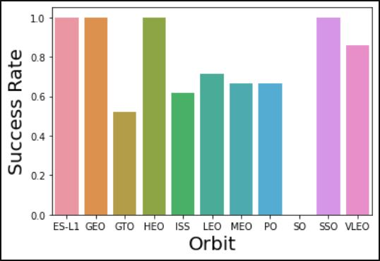
Success Rate vs. Orbit Type
Most successful orbits are:
ES-L1
GEO
HEO
SSO

Slide 23
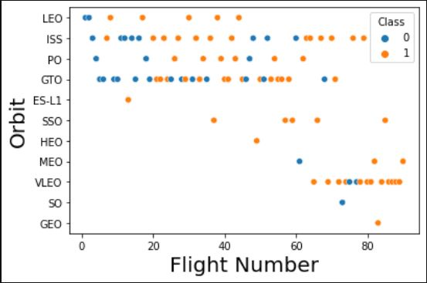
Flight Number vs. Orbit Type
Most of the orbit types show that the more flights the more successful the landing will be except GTO

Slide 24
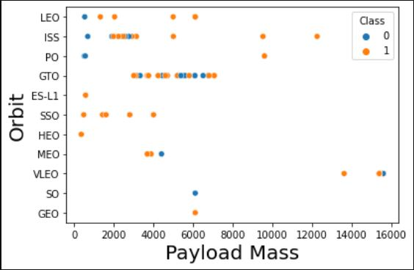
Payload vs. Orbit Type
With heavy payloads, the successful landing or positive landing rate is more for Polar, LEO, and ISS.
However, we cannot distinguish this well for GTO as both positive landing rate and negative landing(unsuccessful mission) are here.

Slide 25
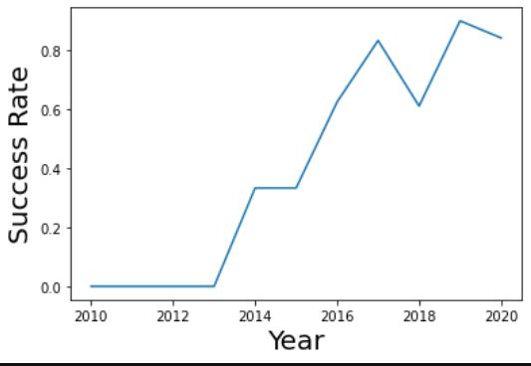
Launch Success Yearly Trend
The more the years go the more successful the launches are
Doesn’t really tell much other than that modern technology is more reliable than it used to be

Slide 26
All Launch Site Names
Launch Sites
CCAFS LC-40
VAFB SLC-4E
KSC LC-39A
CCAFS SLC-40
Obtained from the data by extracting unique names from the column ‘Launch_Site’

Slide 27
Launch Site Names Begin with 'CCA'
Date | Time (UTC) | Booster_Version | Launch_Site | Payload | PAYLOAD_MASS__KG_ | Orbit | Customer | Mission_Outcome | Landing_Outcome
4/6/2010 | 18:45:00 | F9 v1.0 B0003 | CCAFS LC-40 | Dragon Spacecraft Qualification Unit | 0 | LEO | SpaceX | Success | Failure (parachute)
8/12/2010 | 15:43:00 | F9 v1.0 B0004 | CCAFS LC-40 | Dragon demo flight C1, two CubeSats, barrel of... | 0 | LEO (ISS) | NASA (COTS) NRO | Success | Failure (parachute)
22-05-2012 | 7:44:00 | F9 v1.0 B0005 | CCAFS LC-40 | Dragon demo flight C2 | 525 | LEO (ISS) | NASA (COTS) | Success | No attempt
8/10/2012 | 0:35:00 | F9 v1.0 B0006 | CCAFS LC-40 | SpaceX CRS-1 | 500 | LEO (ISS) | NASA (CRS) | Success | No attempt
1/3/2013 | 15:10:00 | F9 v1.0 B0007 | CCAFS LC-40 | SpaceX CRS-2 | 677 | LEO (ISS) | NASA (CRS) | Success | No attempt
Sample data of Cape Canaver Launches

Slide 28
Total Payload Mass
Total Payload mass carried by NASA is 48,213 kilograms
Sum of “Payload_Mass_Kg” column for rows with the value “NASA (CRS)”

Slide 29
Average Payload Mass by F9 v1.1
The average payload mass carried by booster version F9 v1.1 is
2534.66 kilograms
The calculated average of the column “Payload_Mass_Kg” for rows with the value “F9 v1.1”

Slide 30
First Successful Ground Landing Date
the date of the first successful landing outcome on ground pad was in:
2017/05/01
Found the earliest date for the rows with “Success (ground pad)”

Slide 31
Successful Drone Ship Landing with Payload between 4000 and 6000
The names of boosters which have successfully landed on drone ship and had payload mass greater than 4000 but less than 6000:
Names were extracted by filtering out distinct names of booster version that had “Success (drone ship)” and their Payload masses were between 4000 and 6000 kilograms
Booster Version
F9 FT B1022
F9 FT B1026
F9 FT B1021.2
F9 FT B1031.2

Slide 32
Total Number of Successful and Failure Mission Outcomes
Out of 102 mission outcomes:
100 were successful
2 were failures
Counted all the rows grouped by the column “Mission_Outcomes”

Slide 33
Boosters Carried Maximum Payload
Booster Version
F9 B5 B1048.4
F9 B5 B1049.4
F9 B5 B1051.3
F9 B5 B1056.4
F9 B5 B1048.5
F9 B5 B1051.4
F9 B5 B1049.5
F9 B5 B1060.2
F9 B5 B1058.3
F9 B5 B1051.6
F9 B5 B1060.3
F9 B5 B1049.7
Max payload mass: 15,600 KG
Created a subquery for the maximum payload mass right joined all booster versions that matched the value.

Slide 34
2015 Launch Records
Failed landing outcomes in drone ships:
2 Failures in launch were recorded in 2015. Done by filtering the date by 2015 with “landing_outcomes” equaling “Failure (drone ship)”
Booster Version | Launch Site
F9 v1.1 B1012 | CCAFS LC-40
F9 v1.1 B1015 | CCAFS LC-40

Slide 35
Rank Landing Outcomes Between 2010-06-04 and 2017-03-20
Landing Outcomes | COUNT
Success | 20
No attempt | 10
Success (drone ship) | 8
Success (ground pad) | 6
Failure (drone ship) | 4
Failure | 3
Controlled (ocean) | 3
Failure (parachute) | 2
No attempt | 1
Between 2010/06/04 – 2017/03/20 out of the total outcomes successful landings were the most common.

Slide 36

Section 3

Slide 37
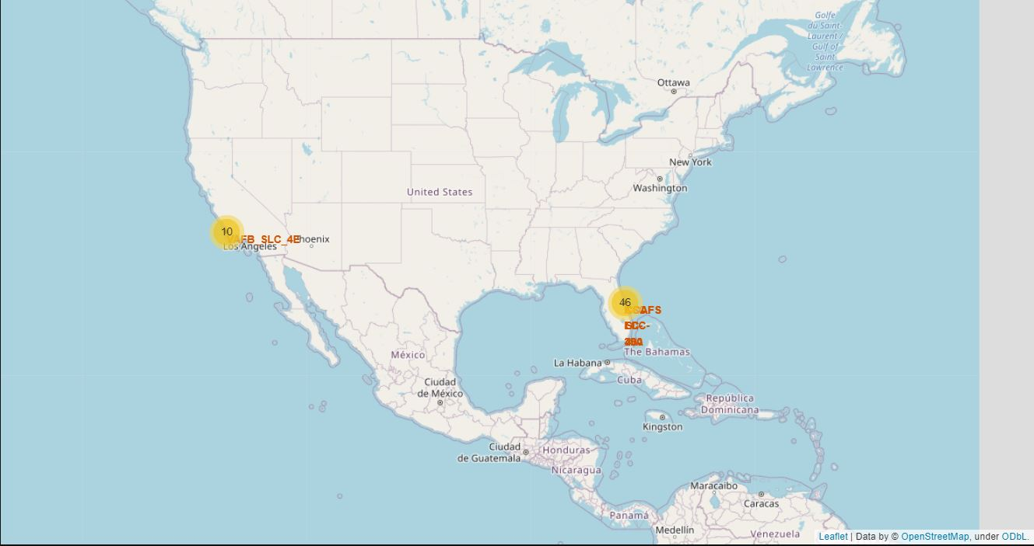
Launch Sites map
All the Launches were made near the coasts but were close to railroad networks and infrastructures

Slide 38
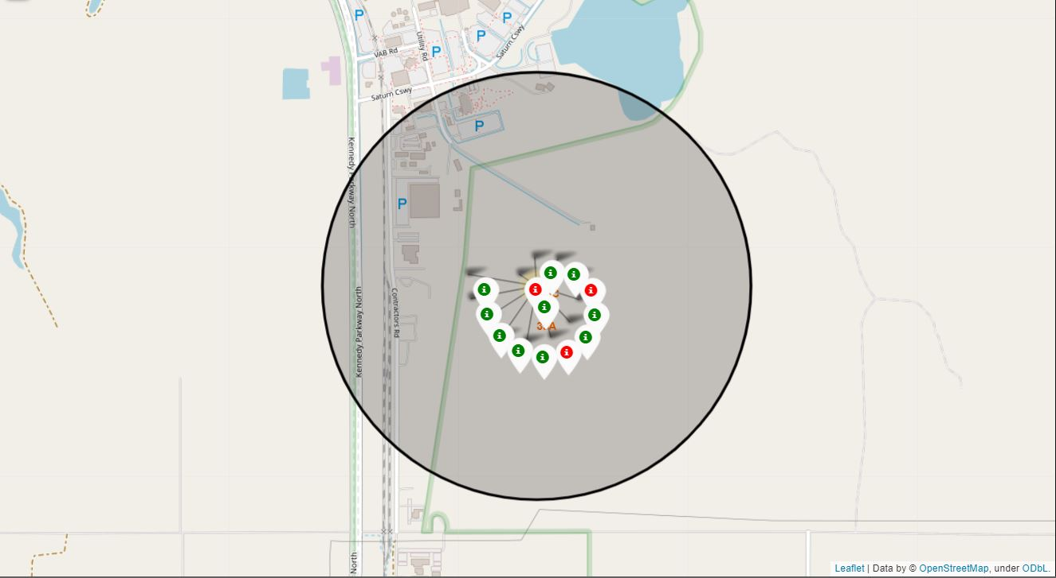
KSC LSC 39A site map
Green markers indicate success, red indicates failures
Has a high success rate

Slide 39
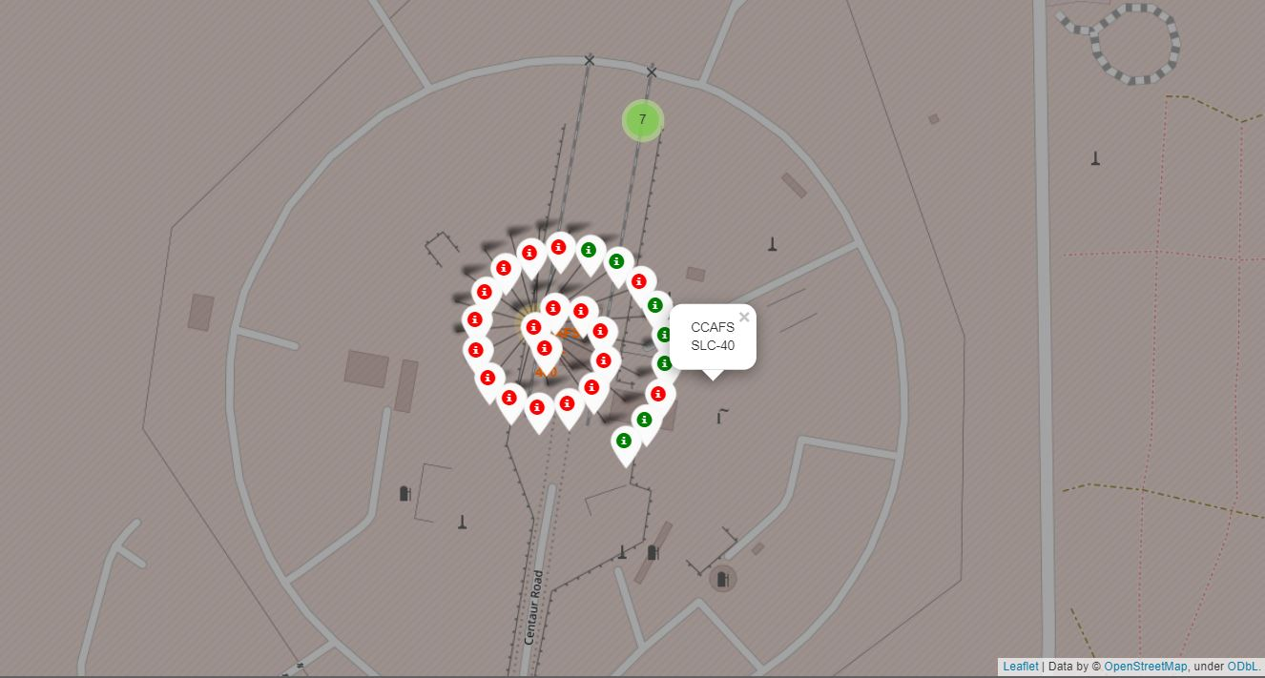
CCAFC SLC 40 map
Most used launching site
Has a not so high successful rate

Slide 40

Section 4

Slide 41
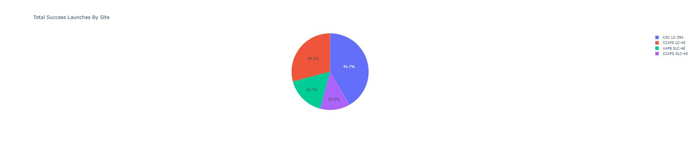
Launch success by sites
Launch sites seem to have effect on whether the launch will be successful or not

Slide 42
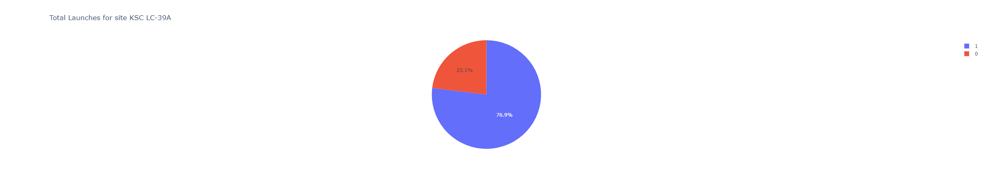
Launch outcomes for KSC LC-39A
1 = success, 0 = failure
KSC LC-39A site has 77% success rate and seems to be the ideal launch site

Slide 43
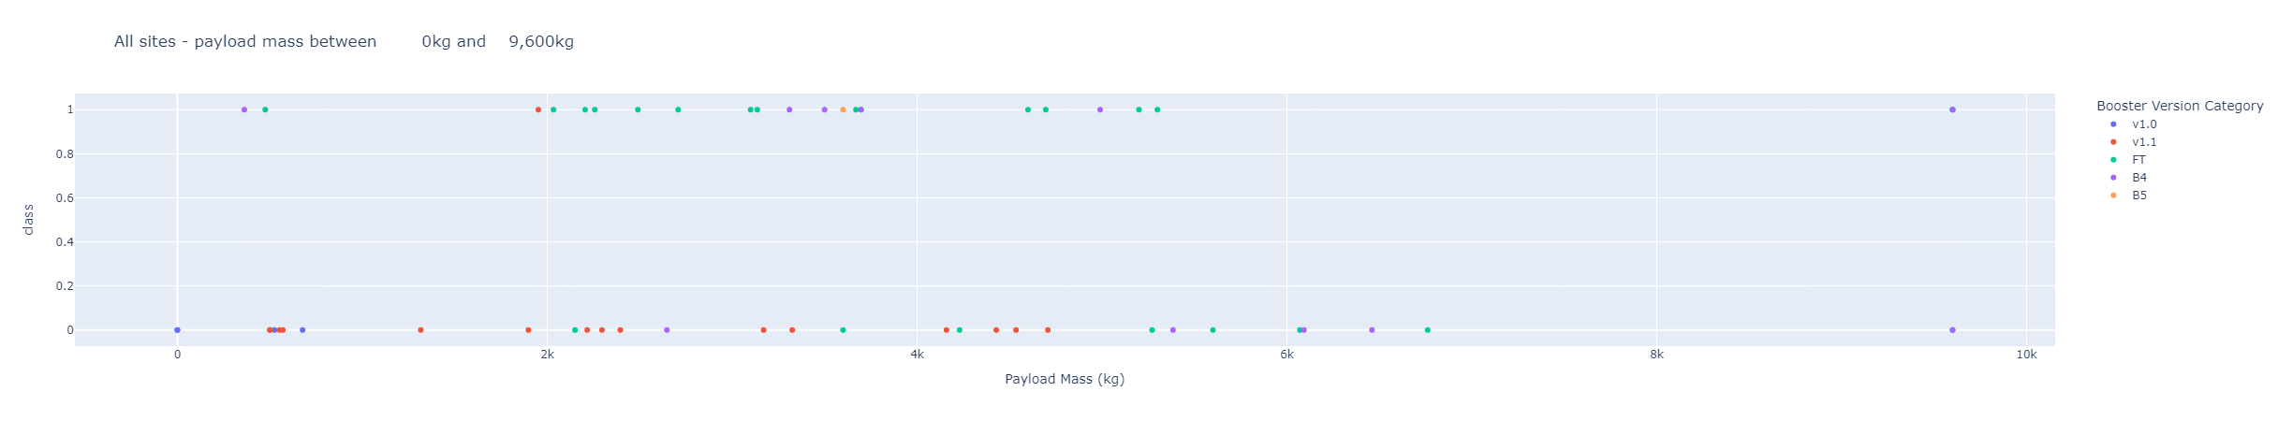
Payload mass vs Outcome
FT version of boosters with a payload range of 2k-4k seems to be the most successful ones

Slide 44

Section 5

Slide 45
Classification Accuracy
4 models of forecasting were trained and tested.
Due to the small size of data, the 4 models don’t really have a difference when it came to tests but the Decision Tree model showed the most accuracy out of all the models

Slide 46
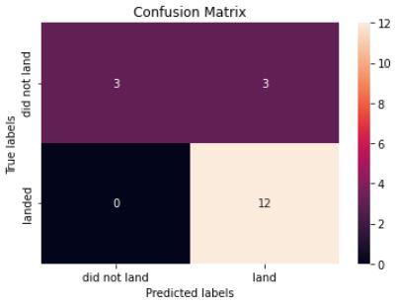
Confusion Matrix
Confusion matrix of the Decision Tree Classifier model.
Major problem with the model seems to be False positives

Slide 47
Conclusions
KSC LC-39A site seems to be the Ideal launch site
Successful landings will get more and more as time goes by (doesn’t mean much)
Payload mass should be between 2000-6000 kgs with a booster similar with FT
Decision tree classification model yielded the best accuracy but the data seems to be too small to make any meaningful decisions.

Slide 48
Appendix
Github link

Slide 49


